Slide 1
Analysis of house prices in London 1995-2019
Springboard Data Science Capstone Project I
Akiro Semtei-Rotundo

Slide 2
INTRODUCTION
Highly volatile market is very sensitive to macroeconomic events.
Price estimation is critical to evaluate the ultimate performance of new properties to develop
Coronavirus economic impact can be measured with the difference in expected prices from the model and the market offers in June 2020

Slide 3
OBJECTIVE
To predict house prices in a corona-free projection of growth.
To compare prices in the real world post-covid impacts with the expected growth forecasted historically.

Slide 4
DATA ACQUISITION
DATASET 1
‘Price Paid Data’ or PPD includes information on all property sales in England and Wales that are sold for value and are lodged with HRMC for registration; the data contains HM Land Registry.
DATASET 2
National Statistics Postcode Lookup (NSPL) for the UK. The NSPL relates both current and terminated postcodes to a range of current statutory geographies via ‘best-fit’ allocation from the 2011 Census Output Areas
DATASET 3
Digital geoJSON vector boundaries for Local Authority Districts in the United Kingdom as of 1 April 2019.

Slide 5
DATA EXPLORATION
24.2 million transactions in real estate since 1995
Lowest price is £1, highest £120m
IQR, modified to include a higher range in the top end limits our study space to properties between £50k and £1.12m. Over 90% of all sales are included within these 2 prices.
We filter by the 32 London borough to focus our study in the capital’s market.

Slide 6
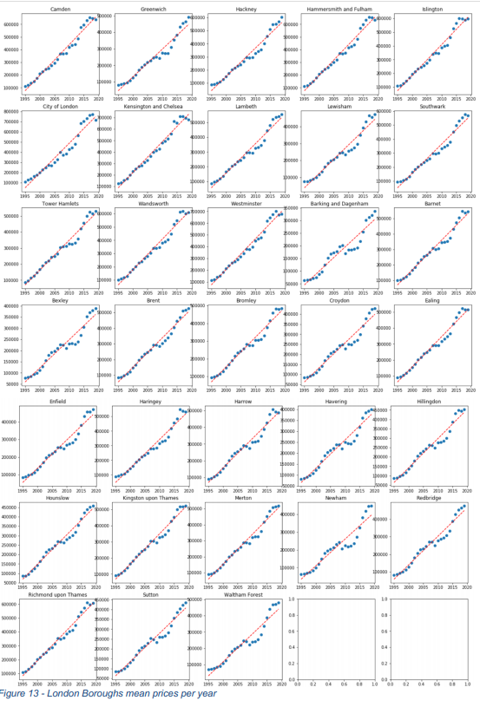
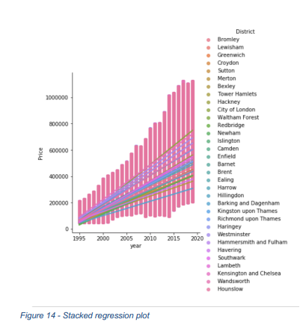
VISUAL ANALYSIS

Slide 7
THE MODEL
All numeric data is scaled.
All categoric data is encoded.
Target variable is analyzed both as ‘y’ and ‘log(y)’
We apply XGBOOST and RFR algorithms.

Slide 8
XGBOOST
Hyperparameter tuning with 5% of data and a GridSearchCV and 5 cross validation splits.
Best params: Gamma = 0.9 / Max-Depth = 12 / Min-child-weight = 13
Apply model for target y and log(y)

Slide 9
RANDOM FOREST REGRESSOR
Hyperparameter tuning with 5% of data and a GridSearchCV and 3 cross validation splits.
Best params: Min-samples-leaf = 1 / Min-samples-split = 10 / n-estimators = 200
Apply model for target y and log(y)

Slide 10
RESULTS COMPARISON
XGBOOST RFR
RMSE y 65,804 65,850
RMSE log(y) 66,764 66,149
Top Feature Long Date
2nd Feature Lat Long

Slide 11
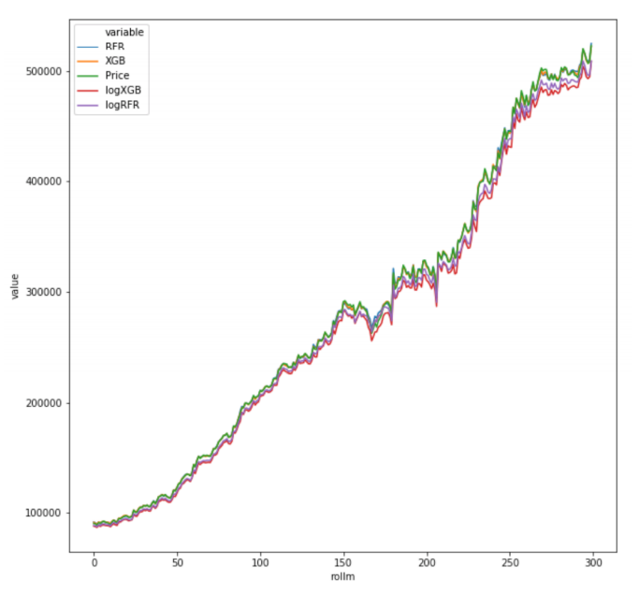
USING THE MODEL
Model predicts the price for an average property at any postcode/datetime combination with an accuracy of +-£65k across all London.
The Model is limited to properties whore real price varies between £50k and £1.12m

Slide 12
CONCLUSIONS
XGBOOST has a small edge over RFR in terms of results that is almost negligible. However, compiling XGBOOST is significantly faster with an average run of 1.24min compared to 2.44min for RFR.
The model can be improved by adding more features, however that data is unavailable and has been requested for academic purposes to Zoopla and RightMove.
We can predict the prices of houses in a corona-free economy with some certainty helping surveyors determine the real impact of the virus-caused economic downturn

